Slide 1

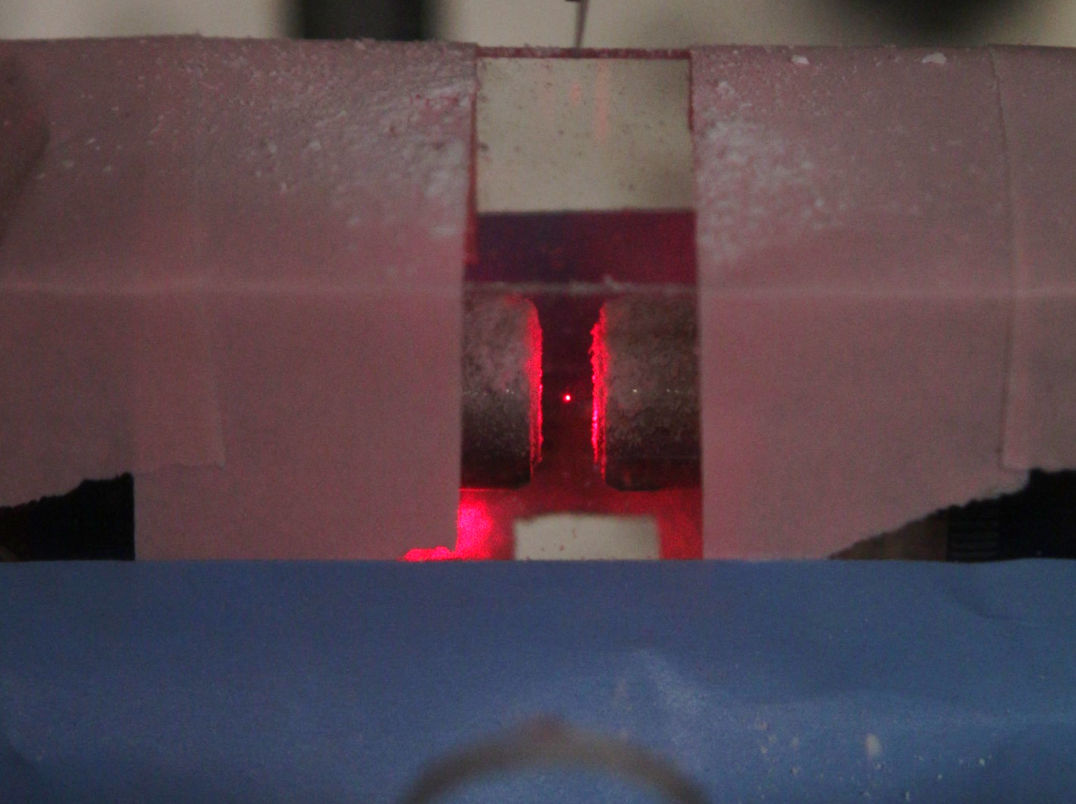
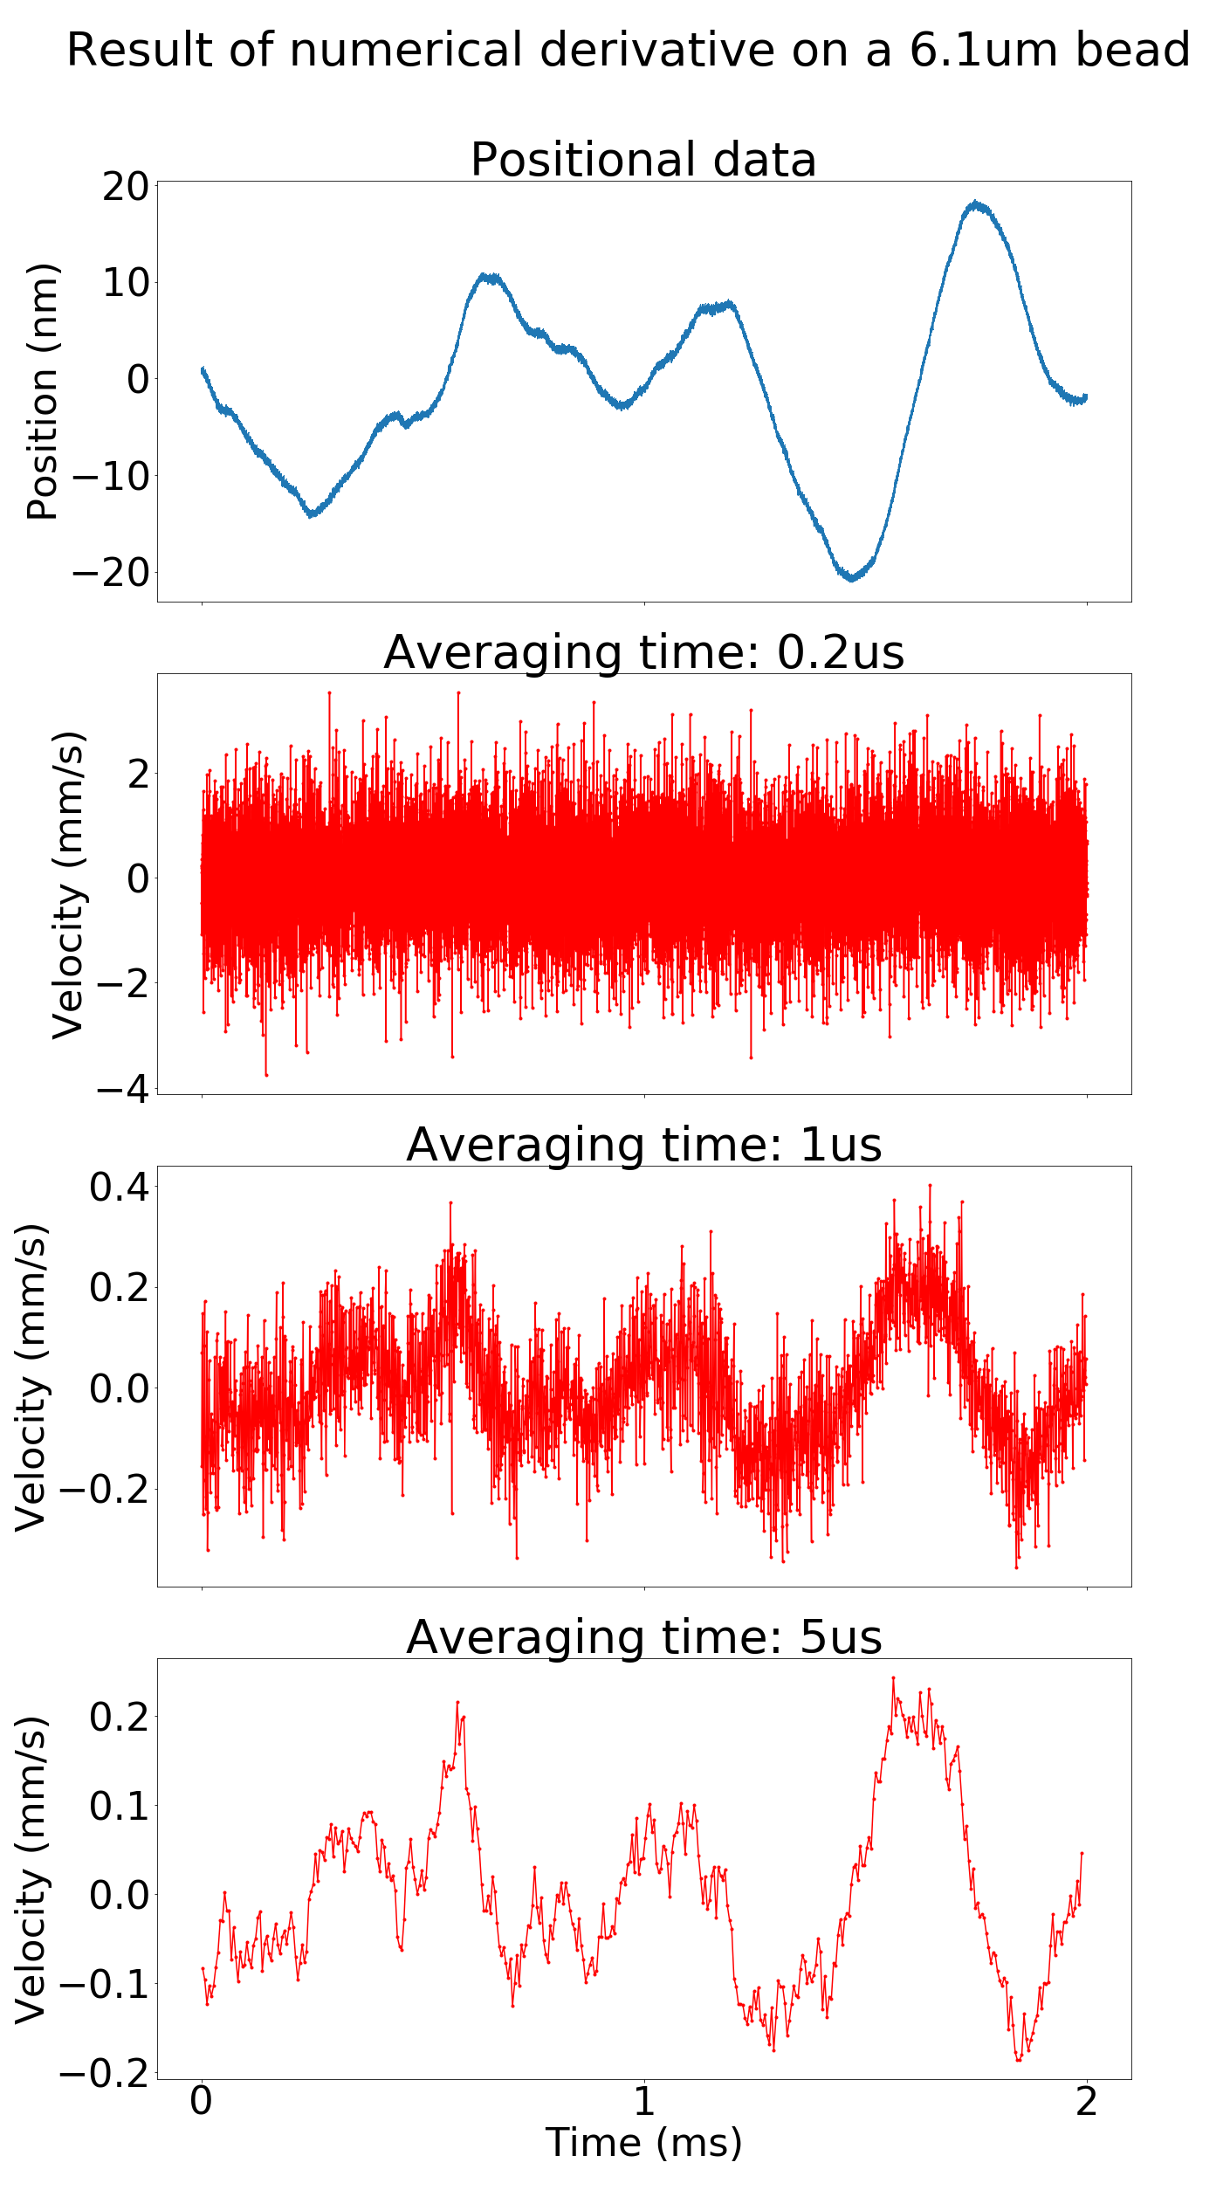
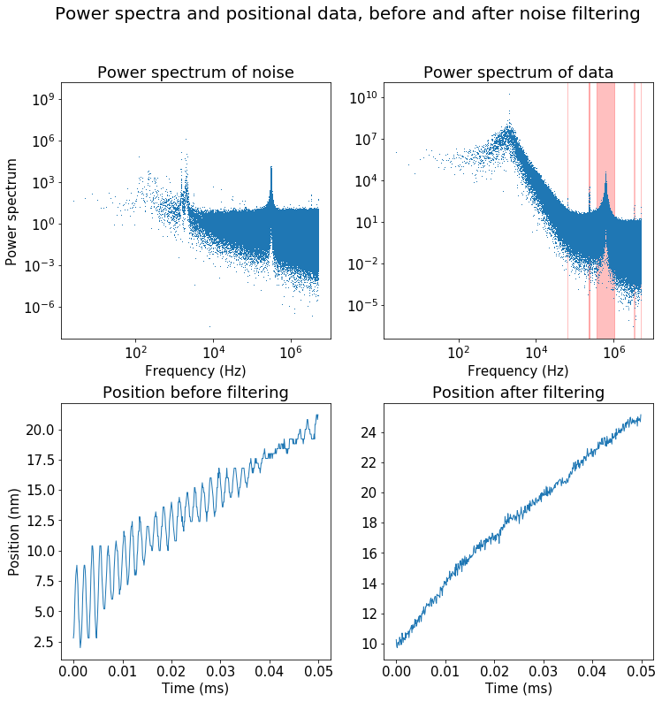
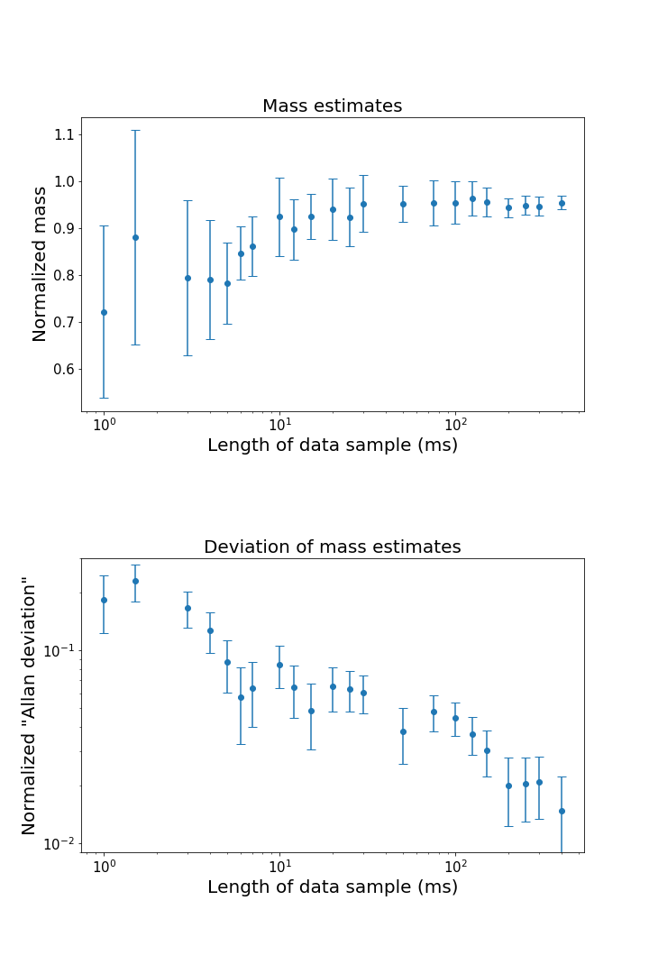
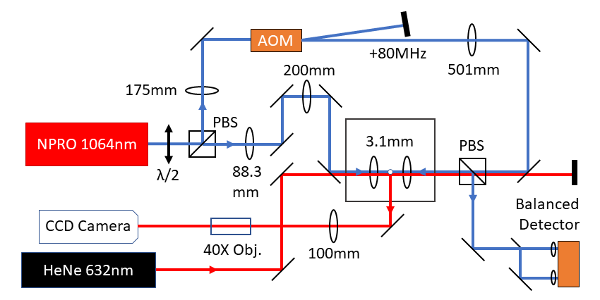
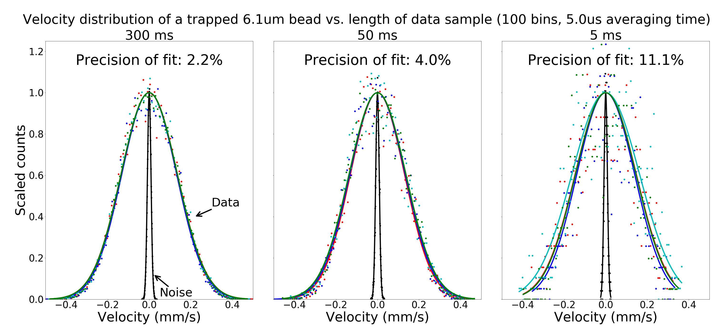
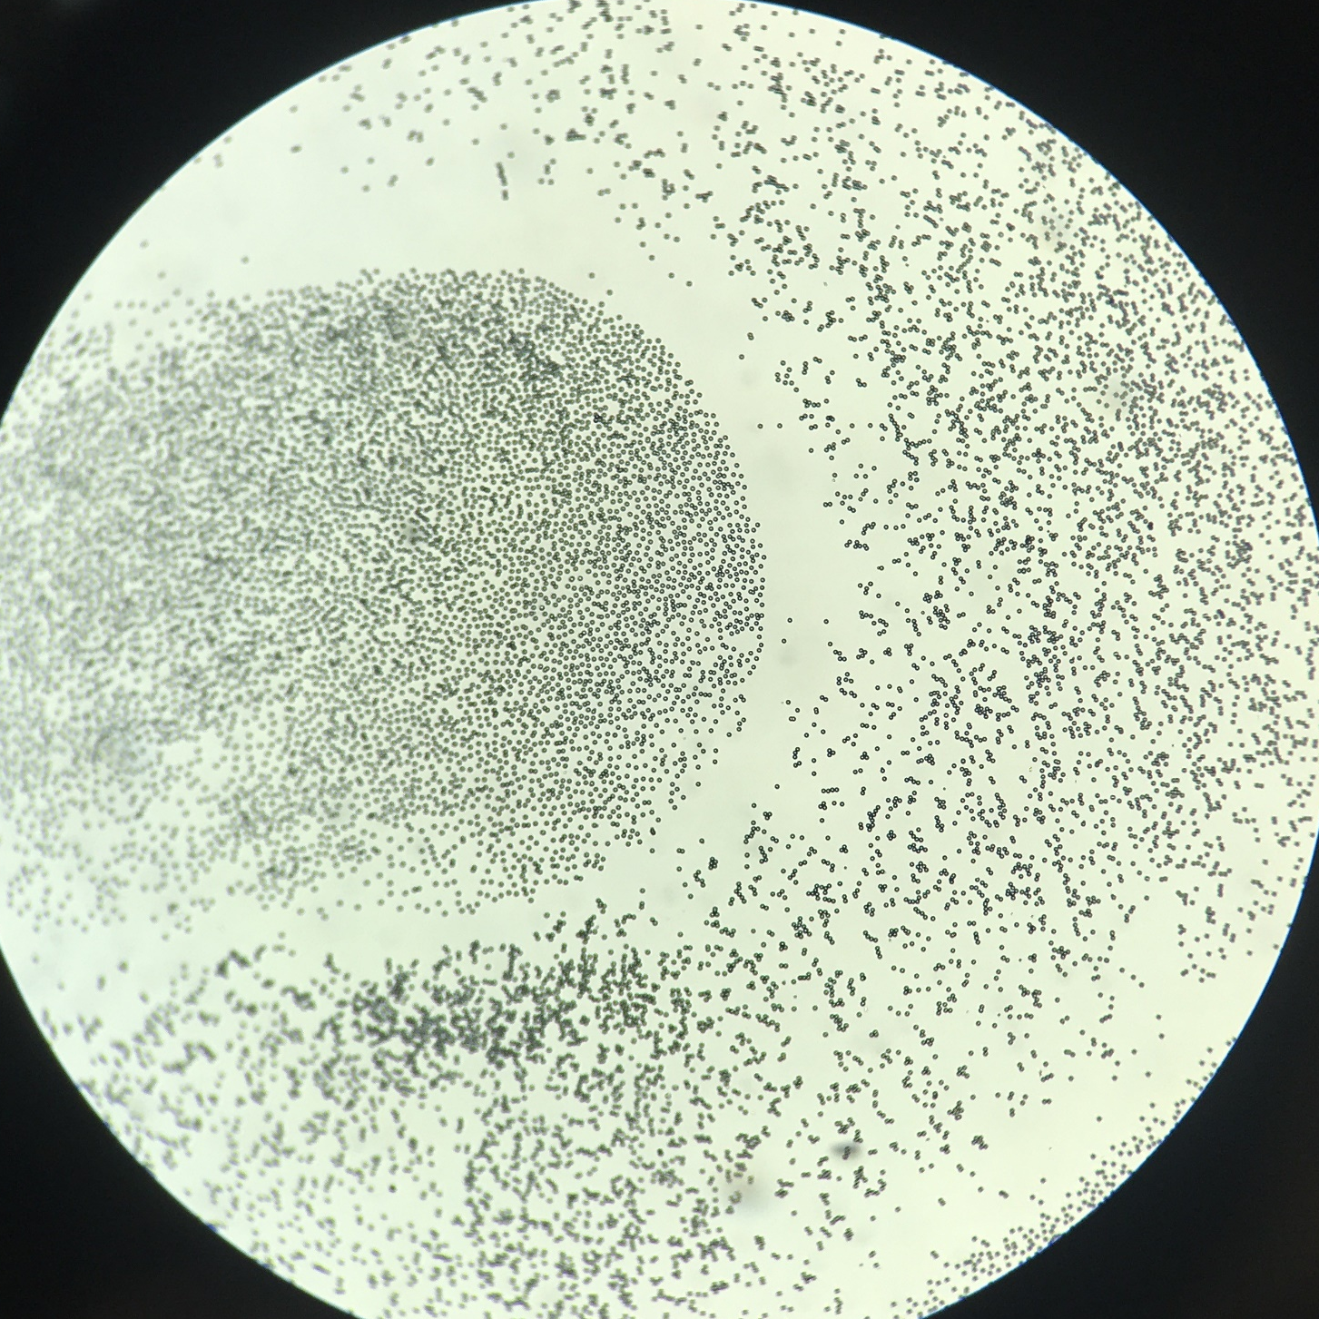

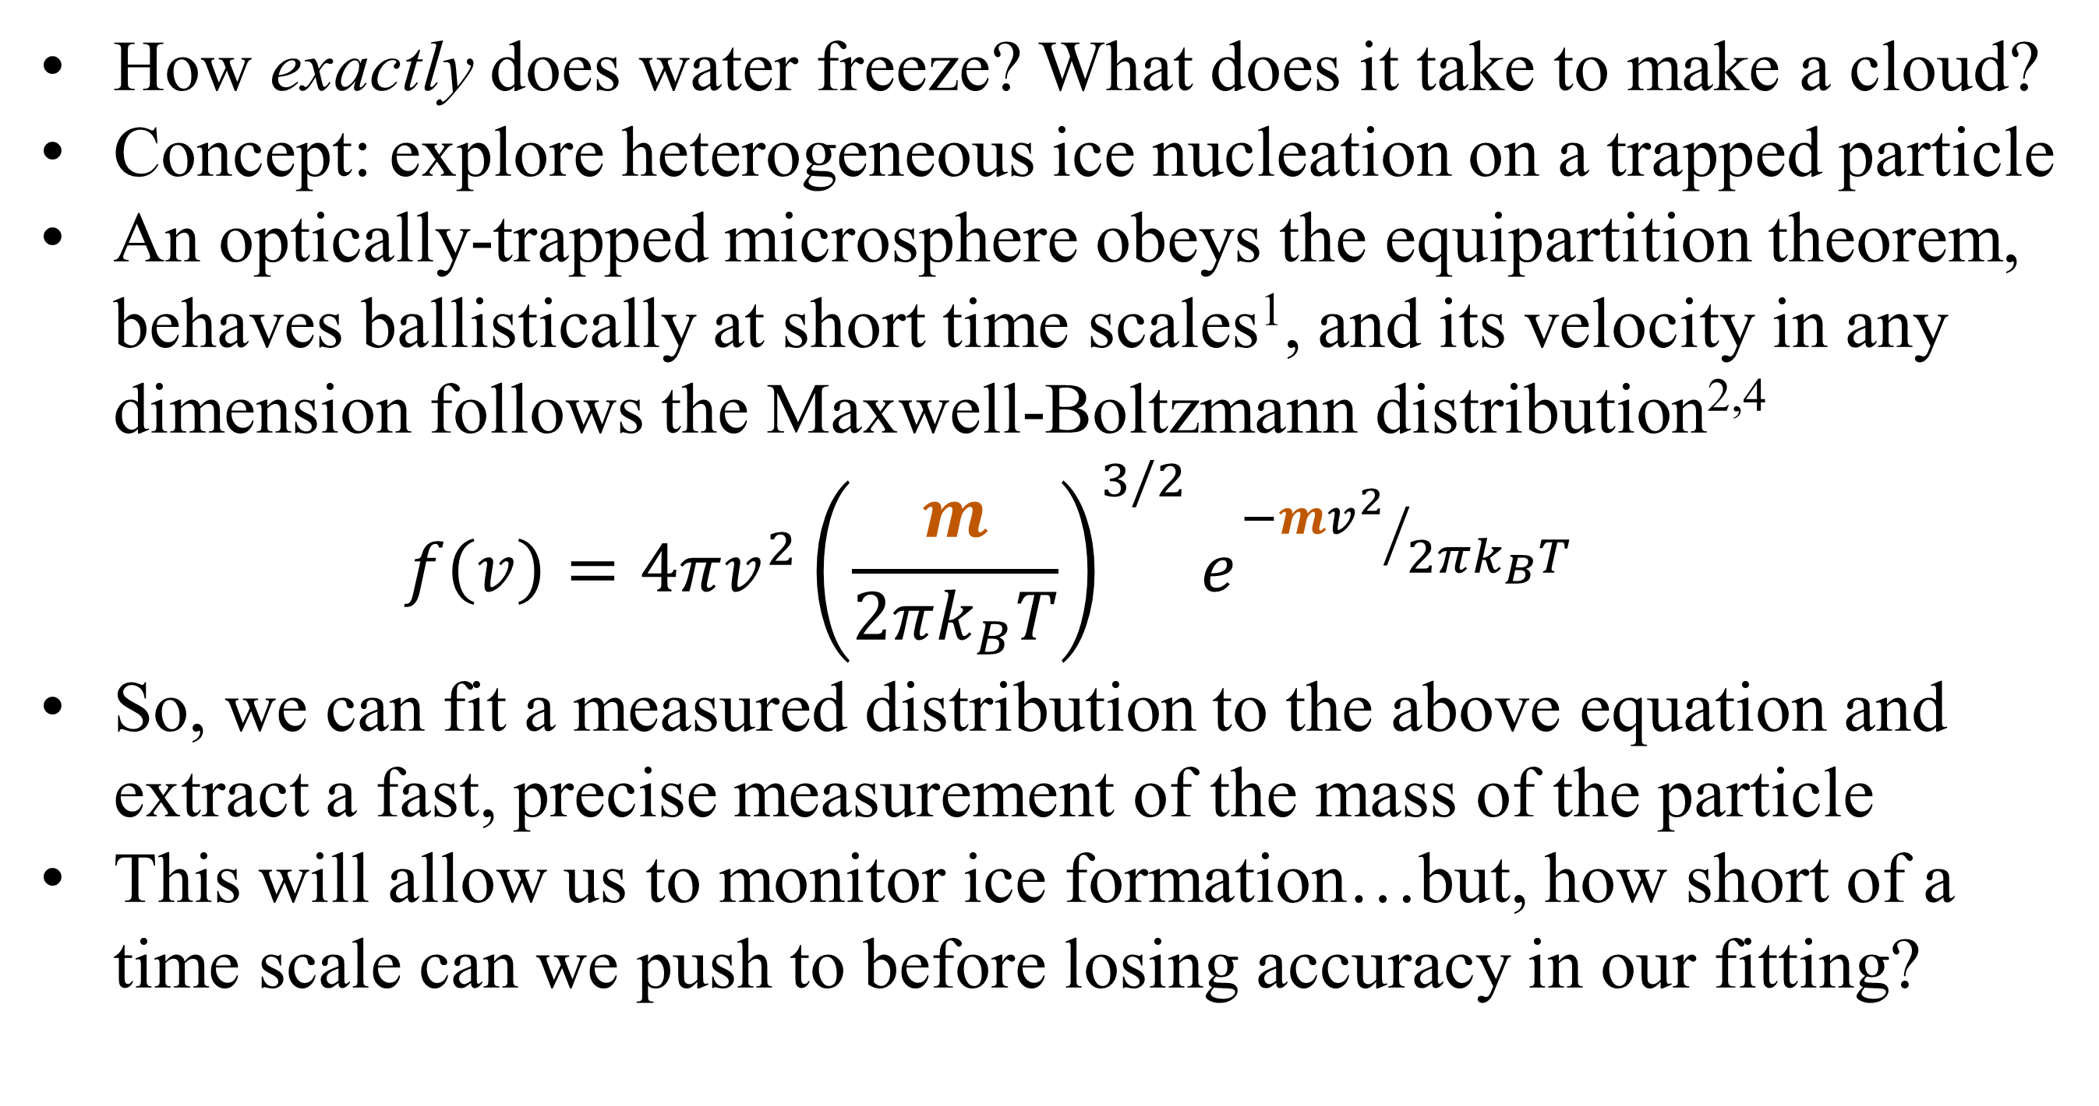
Using the instantaneous velocity of a Brownian particle in an optical tweezer to measure changes in mass
Gabriel H. Alvarez*, Julia E. Orenstein, Lichung Ha, Diney S. Ether Jr., Mark G. Raizen
University of Texas at Austin, Austin, TX (*Stanford University, Stanford, CA)
Motivation
Data and Results
Noise Canceling
How exactly does water freeze? What does it take to make a cloud?
Concept: explore heterogeneous ice nucleation on a trapped particle
An optically-trapped microsphere obeys the equipartition theorem, behaves ballistically at short time scales¹, and its velocity in any dimension follows the Maxwell-Boltzmann distribution^{2,4}
$$f\left(v\right)=4πv^{2}{\left(\frac{m}{2πk_{B}T}\right)}^{3/2}e^{{−mv^{2}}/{2πk_{B}T}}$$
So, we can fit a measured distribution to the above equation and extract a fast, precise measurement of the mass of the particle
This will allow us to monitor ice formation…but, how short of a time scale can we push to before losing accuracy in our fitting?
After aligning the tweezers with a 5um pinhole, we are able to trap beads—ranging from 3.17um to 6.10um in diameter—indefinitely
We can Fourier transform the data to inspect power spectra
Noise presents itself at specific frequencies which can be filtered from the Fourier transform
Finally, apply inverse Fourier transform after filtering out peaks – this returns cleaner positional data (effect on uncalibrated data shown below)
1cm
Calibration factor α converts voltage across PD to positional data
To increase our SNR, we average several positional values before obtaining instantaneous velocities and plotting their distribution against the model
4.5Å resolution in 5us
Experimental Setup
Counter-propagating dual-beam optical tweezer
Two orthogonally-polarized NIR (1064nm) beams used for trapping
An AOM shifts the frequency of one beam to prevent standing wave from forming in the trap
Weak red (632nm) laser used for illumination
One trapping beam split by sharp mirror, used for detection
Balanced photodetector measures displacements of bead in 1D
CCD camera monitors light scattered by bead
Precision is estimated via the ratio of the std. deviation of mass measurements of the same bead to the mean mass
As shown below, even at time scales on the order of a few ms, we can measure the mass of the particle within about 10%
Towards Observing Ice Nucleation
We can now take mass measurements in quick succession to observe a particle’s mass as it changes over time
The silica particle will act as a nucleation point, onto which we will blow cold humid air
As ice forms, we expect to observe the mass of the particle increase
Preliminary plans to supplement M-B fitting with measurement of Mie scattering from trapped sphere to estimate size of particle
New analytical tool that will finally enable the fundamental study of ice nucleation, with wide-ranging practical applications in cloud seeding, atmospheric science
Silica microspheres (shown below) applied to glass coverslip with Q-tip, launched from ultrasonic piezoelectric shaker into tweezer
A
References
A
T. Li et al., Measurement of the instantaneous velocity of a Brownian particle. Science 328, 1673 (2010).
T. Li, Ph.D. thesis, University of Texas at Austin, 2011.
S. Kheifets et al., Observation of Brownian Motion in Liquids at Short Times: Instantaneous Velocity and Memory Loss. Science 343, 1493 (2014).
J. Mo et al., Testing the Maxwell-Boltzmann distribution using Brownian particles. Optics Express 23(2), 1888 (2015).
B
100um

